Slide 1
Neural Word Embedding And Language Modelling
A Survey Paper Presentation by
Riddhi Jain
Graduate Student Computer Engineering, SJSU
(014600716)
Notes:
Hello

Slide 2
About
Paper: A survey on Neural Word Embeddings
Authors: ERHAN SEZERER SELMA TEKIR
Article Link: https://arxiv.org/pdf/2110.01804.pdf
Published Date: 2021

Slide 3
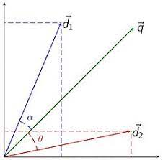
What is VSM?
The vector space model is an algebraic model that represents objects (like text) as vectors. This makes it easy to determine the similarity between words or the relevance between a search query and document. Cosine similarity is often used to determine similarity between vectors.
Notes:
Before neural representation learning, representations of words or documents have been computed using the vector space model. In VSM [120], frequencies of words in documents are considered to form a term-document matrix. Although these count-based representations are proved helpful in addressing semantics, they are the bag of words approaches and are not able to capture both syntactical and semantic features at the same time, which is required for performing well in NLP tasks.

Slide 4
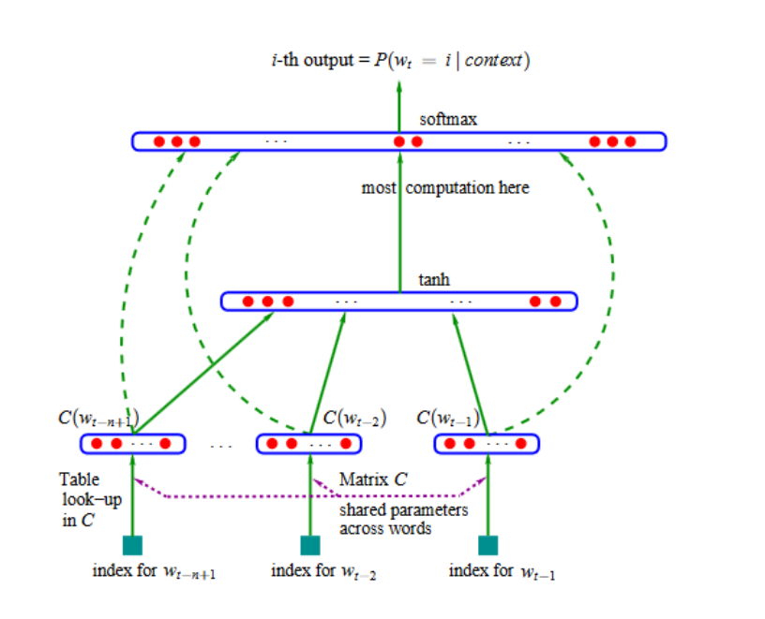
Neural Word Embeddings
Neural network architecture is constructed to predict the next word given the set of neighboring words in the sequence in neural language modeling.
Notes:
Neural network architecture is constructed to predict the next word given the set of neighboring words in the sequence in neural language modeling. In the iterative processing of this prediction over a large corpus, the learned weights in the hidden layers serve as neural embeddings for words.

Slide 5
Word Embeddings with Improved Language Models
Early Word Embeddings
Embeddings Target Specific Semantic Relations
Sense Embeddings
Morpheme Embeddings
Notes:
Although the initial word embedding models successfully identified semantic and syntactic similarities of words, they still need to be improved to address specific semantic relations among words. consider the sentences "She took a sip of hot coffee" and "He is taking a sip of cold water." The antonyms "cold" and "hot" are deemed to be similar since their context is similar. Therefore, it becomes an issue to differentiate the synonyms "warm" and "hot" from the antonyms "cold" and "hot" considering they have similar contexts in most occurrences.
Early word embeddings unite all the senses of a word into one representation. In reality, a word gets meaning in its use and can mean different things in varying context. Sense Embeddings are used to get word sense discrimination as the decomposition of a word’s occurrences into same sense groups

Slide 6
Early Word Embeddings
Word2vec is the first neural word embedding model that efficiently computes representations to leverage the context of target words
Two word2vec variants:
CBOW (Continuous Bag of words)
Example - “nature is pleased with simplicity”
Skip-gram
Notes:
Word2vec is the first neural word embedding model that efficiently computes representations to leverage the context of target words. It can be considered as the initiator of early word embeddings. Word2vec has two variants: Continuous bag of words model (CBOW) and Skip-gram model.
In CBOW - middle word is predicted given the context, set of neighbouring left and right. When the input sentence "nature is pleased with simplicity" is processed, the system predicts the middle word "pleased" given the left and right context
In Skip-gram system predicts the most probable context words for a given input word. In terms of a language model, while CBOW predicts an individual word’s probability, Skip-gram outputs the probabilities of a set of words, defined by a given context size.

Slide 7
Embeddings Target Specific Semantic Relations
Example - “She took a sip of hot coffee” and “He is taking a sip of cold water”
Types of algorithms
SGNS
GloVe
ATTRACT and REPEL
Notes:
Although the initial word embedding models successfully identified semantic and syntactic similarities of words, they still need to be improved to address specific semantic relations among words. consider the sentences "She took a sip of hot coffee" and "He is taking a sip of cold water." The antonyms "cold" and "hot" are deemed to be similar since their context is similar. Therefore, it becomes an issue to differentiate the synonyms "warm" and "hot" from the antonyms "cold" and "hot" considering they have similar contexts in most occurrences.

Slide 8
Sense Embeddings
Early word embeddings unite all the senses of a word into one representation.
In reality, a word gets meaning in its use and can mean different things in varying contexts.
When the issue becomes labeling those sense groups, the task becomes a supervised one
Notes:
Early word embeddings unite all the senses of a word into one representation. In reality, a word gets meaning in its use and can mean different things in varying context. Sense Embeddings are used to get word sense discrimination as the decomposition of a word’s occurrences into same sense groups

Slide 9
Morpheme Embeddings
Proposes several ways to target morphological information in order to obtain sub-word information for solving the rare/unknown word problem of earlier word embedding methods and also to have better representations of words for morphologically rich languages.
Two ways
Training Morphological Embeddings from Scratch
Adjusting the Existing Embeddings
Notes:
The quest for morphological representations is a result of two important limitations of earlier word embedding models.
The first point is, words are not the smallest units of meaning in language. Even if a model does not see
the word unpleasant in the training it should be able to deduce that it is the negative form of pleasant. Word embedding
methods that don’t take morphological information into account can not produce any results in such a situation. The
second limitation is the data scarcity problem of morphologically rich languages and agglutinative languages. Unlike
English, morphologically rich languages have many more noun and/or verb forms inflected by gender, case, or number,
which may not exist in the training corpora. The same thing is also valid for agglutinative languages in which words can
have many forms according to the suffix(es) they take. Therefore, models that take morphemes/lexemes into account
needed.

Slide 10
Datasets
Similarity Tasks
Analogy Task Google Analogy Task with 8869 semantic and 10675 syntactic
Synonym Selection Tasks
Downstream Tasks GLUE benchmark dataset
Notes:
many datasets have been proposed and tested upon. In this section, we report the
structure of the datasets and the performance of the aforementioned word embedding models on them. Depending on their aim, the datasets produced to measure the success of embedding models can be divided into four
Categories:
Similarity Tasks:
Analogy Task
Synonym Selection Task
Downstream Tasks
These datasets provide pairs of words whose similarity is rated by human judgments. They all use Spearman’s rank correlation (𝜌) with average human judgment to measure the performance and quality of embeddings.
Semantic-syntactic word relationship test set (Google Analogy Task) introduced by Mikolov et al. [88] consists of pairs of words in the form of 𝑎 is to 𝑎 ∗ as 𝑏 is to 𝑏 ∗ (such as Paris is to France as London is to England). The aim is to find 𝑏 ∗ , given 𝑎, 𝑎 ∗ , and 𝑏 (cosine distance is used as a distance metric to find the miss-ing word). There are 8869 semantic and 10675 syntactic questions in the dataset, and the success is measured by accuracy
Synonym Selection tasks - this task aims to select the most synonym-like word among the list of candidates. Accuracy (%) is used to measure the performance.
As representations and models get better and the difference between word embedding methods and language models gets closer, experiments are shifted from similarity tasks to downstream tasks. GLUE benchmark dataset [135] is introduced to provide a stable testing environment for researchers.

Slide 11
Conclusion
Human-level language understanding is one of the oldest challenges in computer science. Pre-trained language models’ knowledge has been transferred to fine-tuned task-specific models. Multi-modal language models are based on human language acquisition, where learning starts with concrete concepts through images early on.
Notes:
Recently, contextual models, such as BERT and its variants, showed great success in downstream NLP tasks using masked language modeling and transformer structures. They have become state-of-the-art word embeddings and obtained human-level results on some of the downstream tasks.

